Slide 1
Group 9
A Relational Database Of Soccer Players
Jiangying Zhong, Jingxuan Li, Hongyi Luo, Junfei Ren, Liangze Ni
Notes:
版权声明：300套精品模板商业授权，请联系【锐旗设计】:https://9ppt.taobao.com，专业PPT老师为你解决所有PPT问题！

Slide 2
CONTENTS
Part1 Project Design
Part2 Final ERD
Part3 Create & Insert
Part4 Data Encryption
Part5 Views
Part6 Tableau

Slide 3
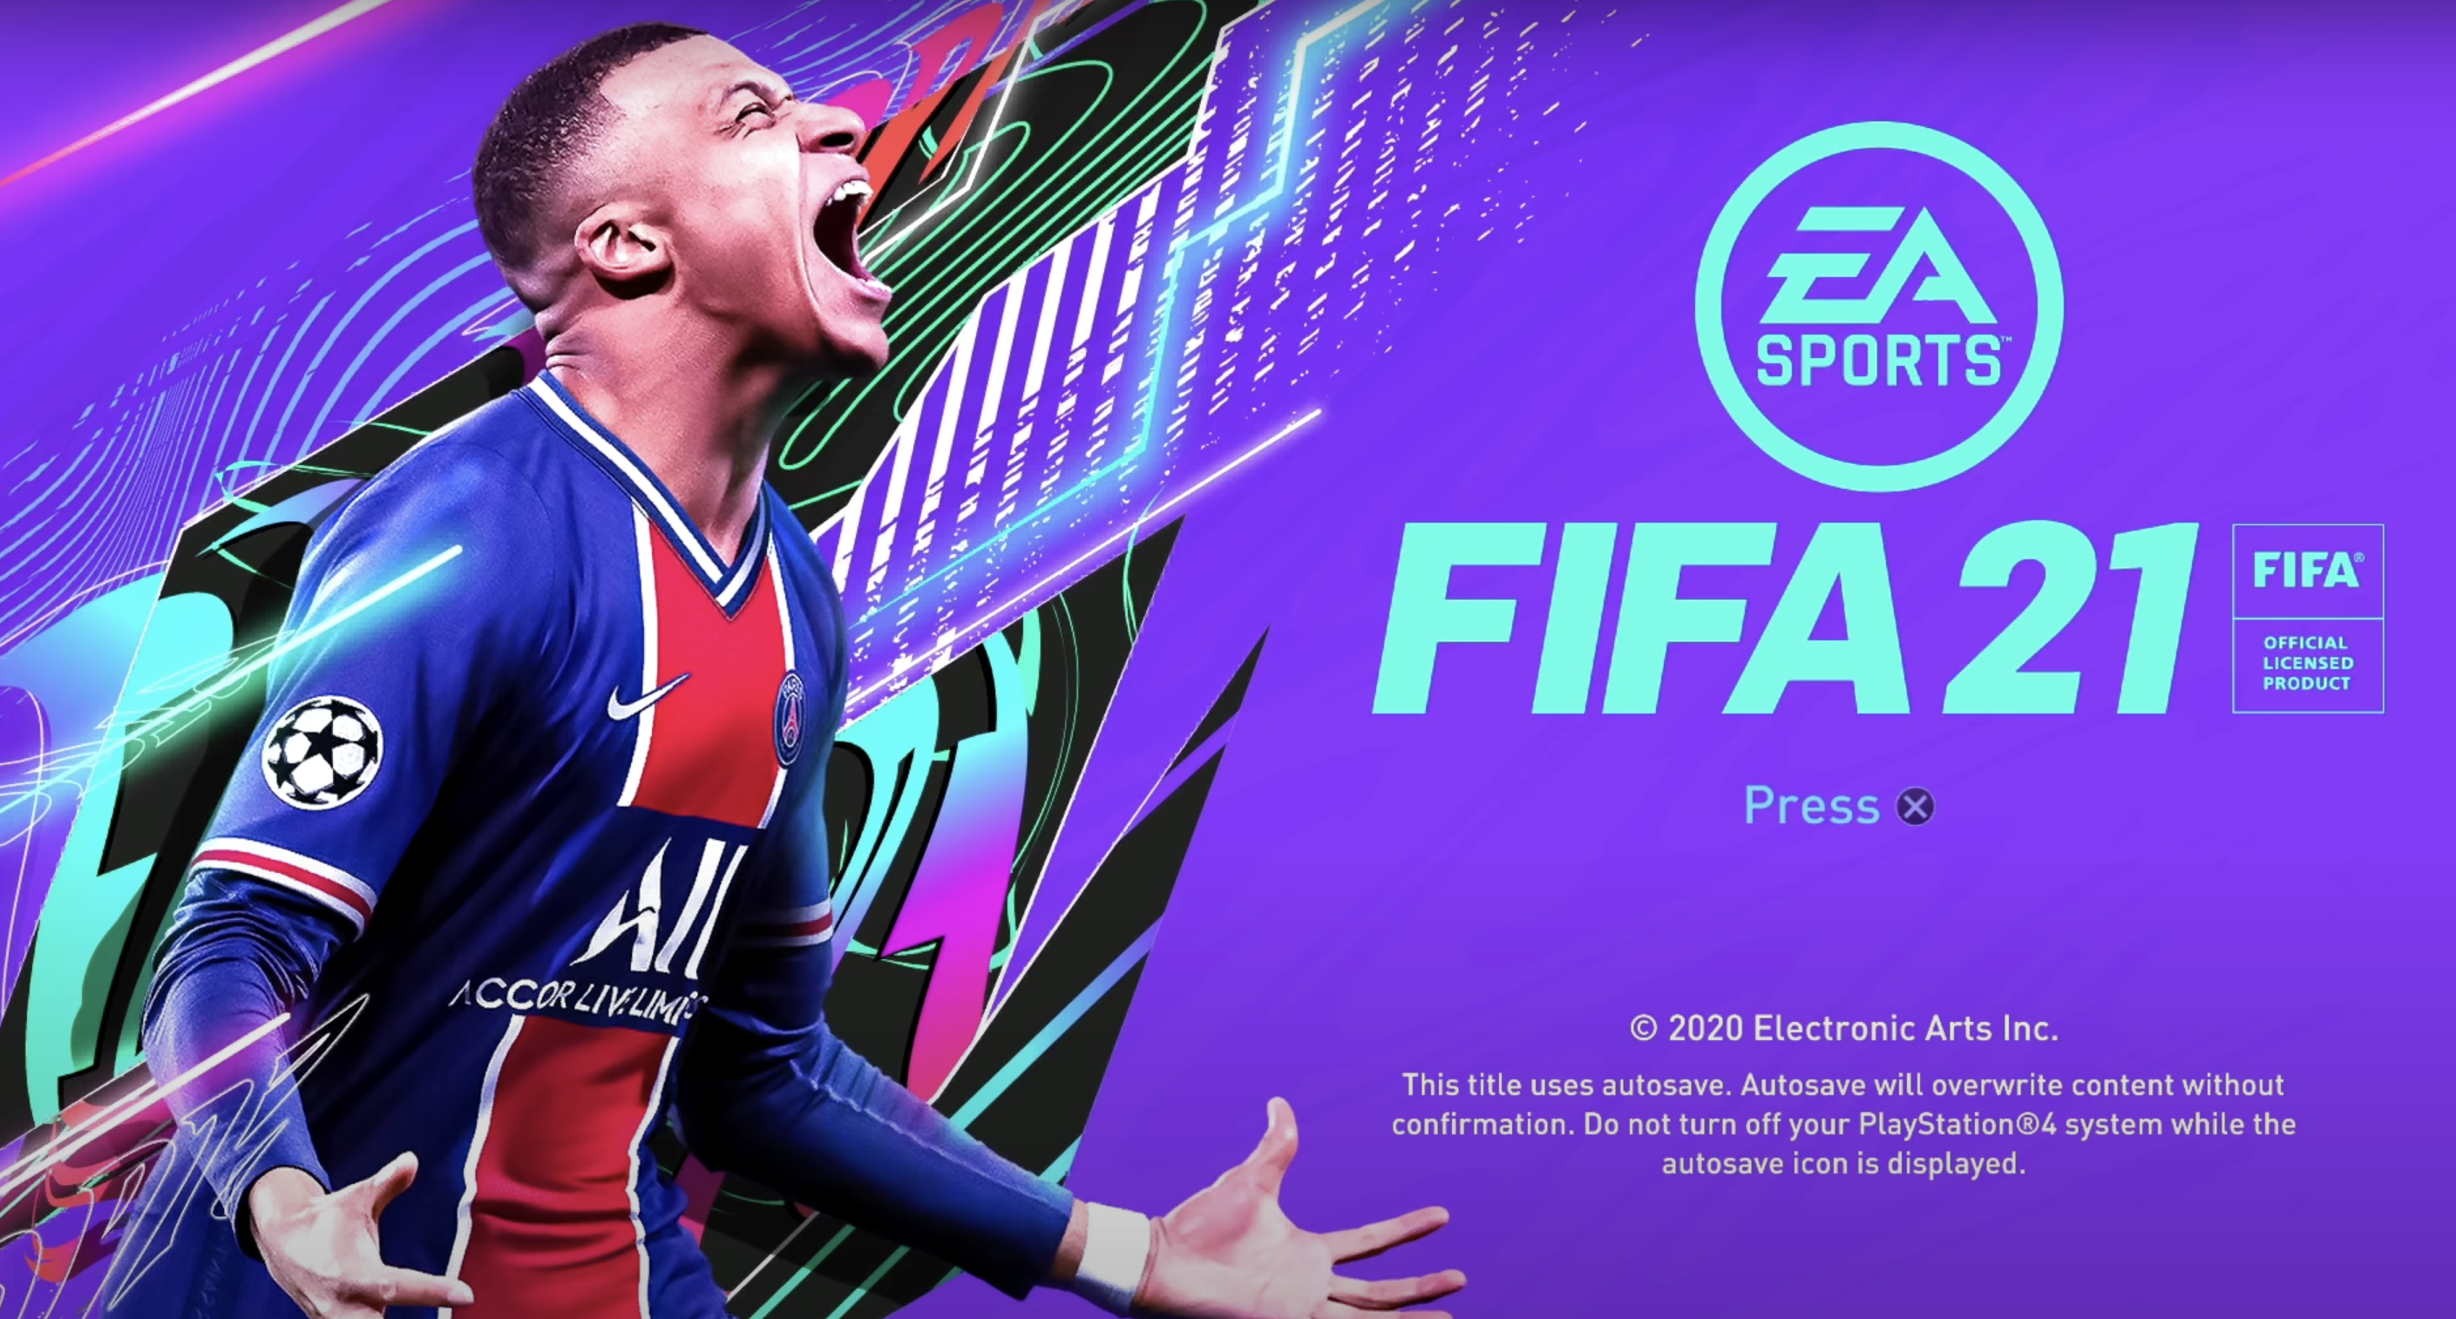
Part1 Project Design
Comprehensive
Real football player’s Data
Reflect different
abilities of players
Notes:
版权声明：300套精品模板商业授权，请联系【锐旗设计】:https://9ppt.taobao.com，专业PPT老师为你解决所有PPT问题！

Slide 4
Part1 Project Design
01
02
03
04
Analyze the strengths
and weaknesses of
football players
Analyze which country and club have better football players
Analyze the dominant foot of a football player
Analyze the relationship between worth and wages and liquidated damages

Slide 5
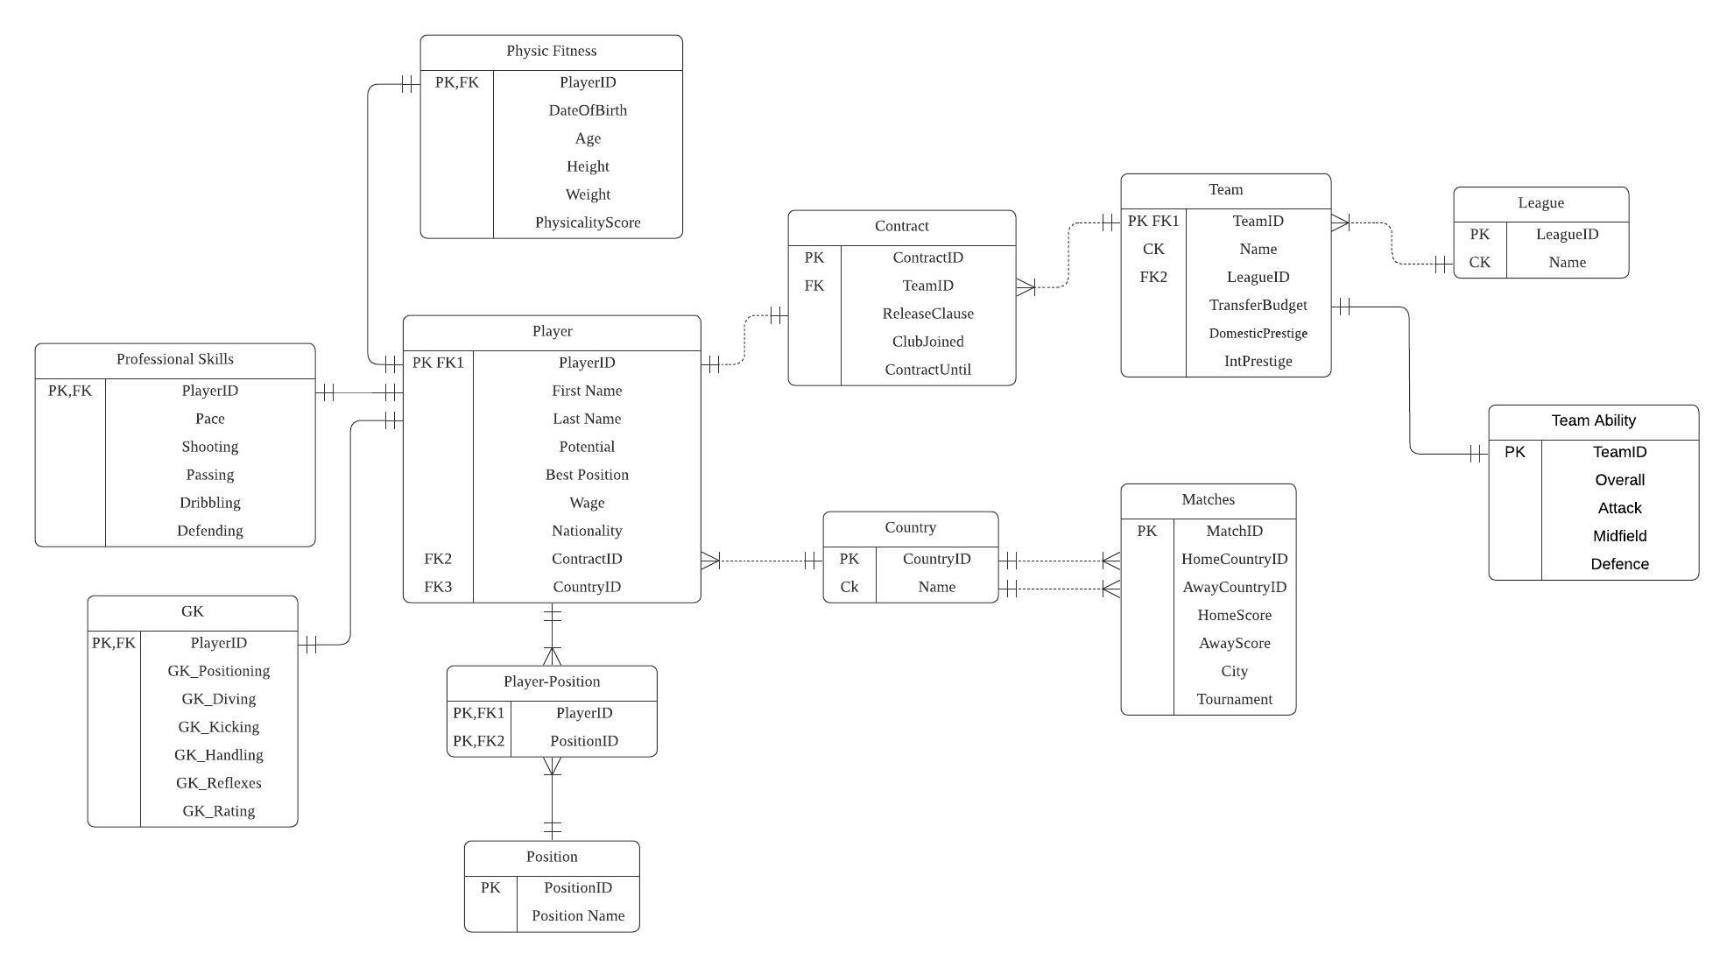
Part2 Final ERD

Slide 6
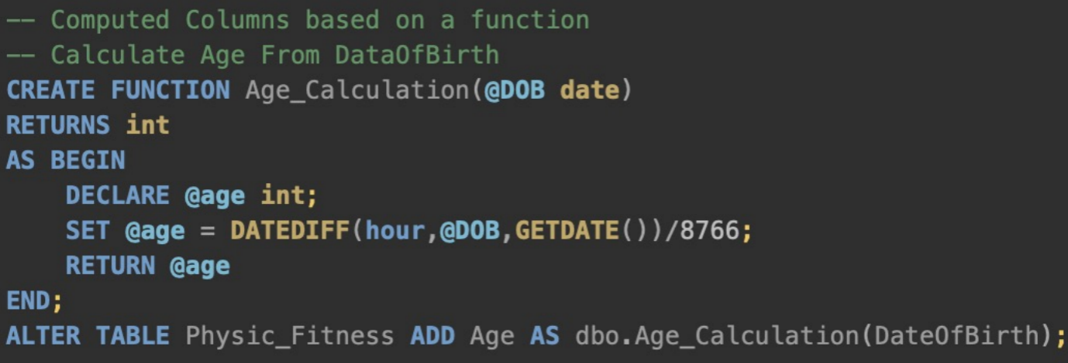
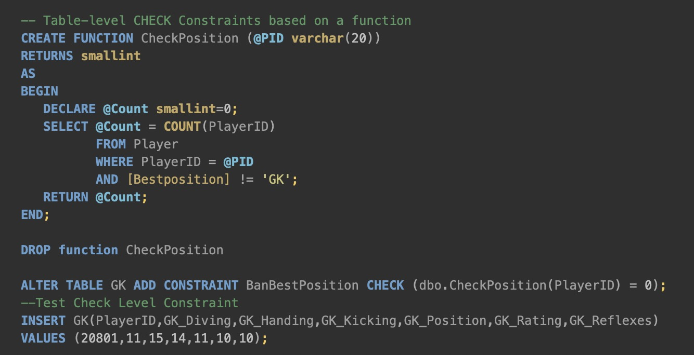
Part3 Create & Insert
Table-level CHECK Constraints based on a function
Computed Columns based on a function

Slide 7
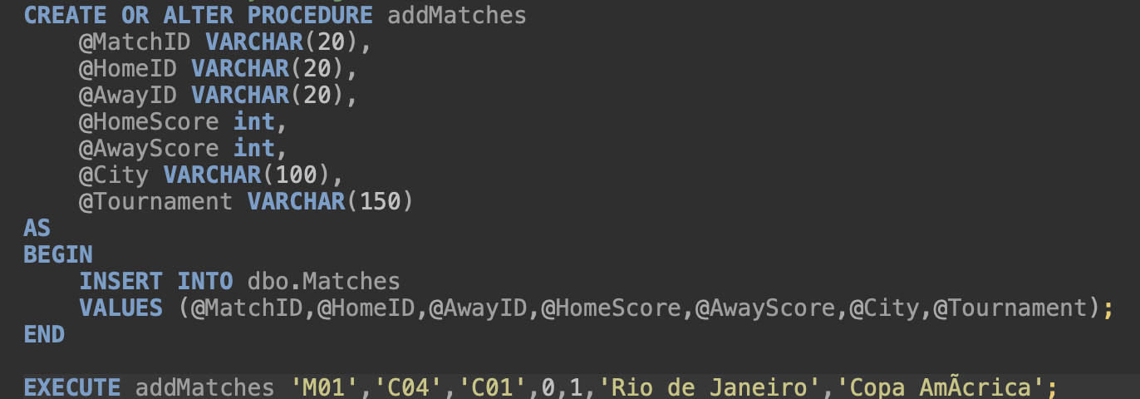
Part3 Create & Insert
INSERT FUNCTION
'Positions','League','Country'
STORED PROCEDURES
'Matches'
'Contract','GK','Physic_Fitness','Player','Player_Position','Professional Skills','Team','Team_Ability'
DATA IMPORT WIZARD

Slide 8
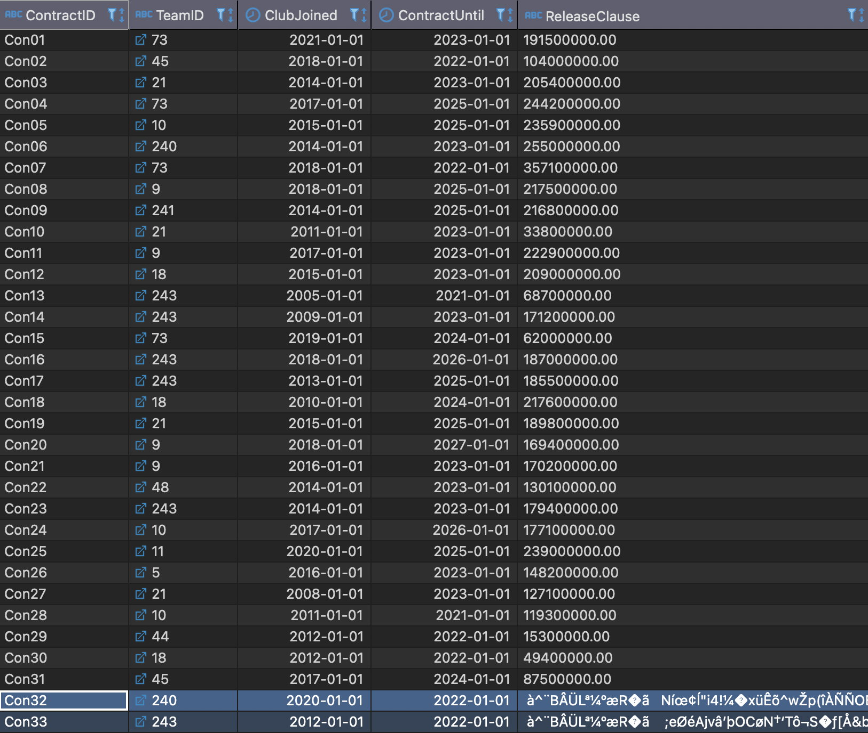
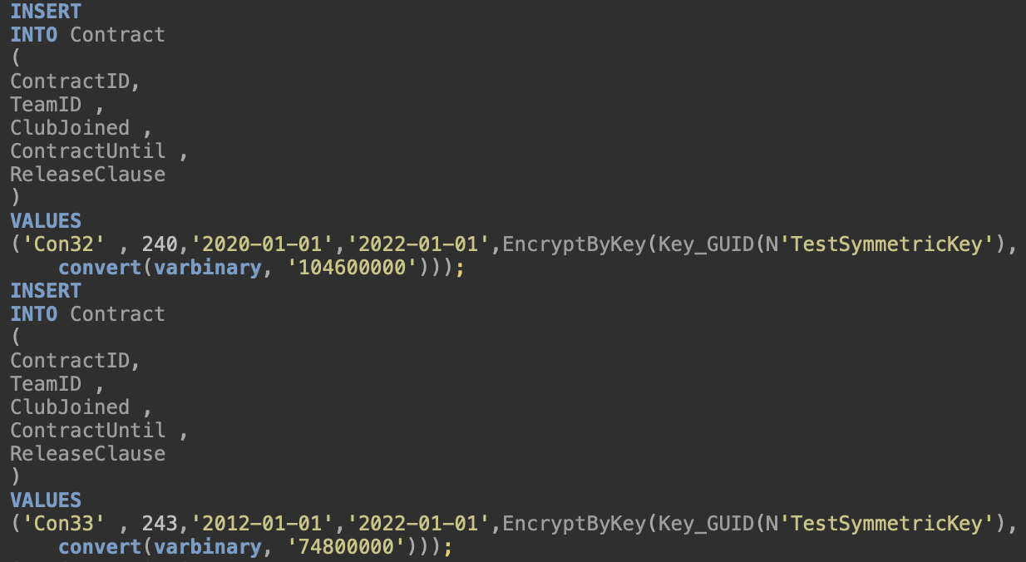
Part4 Data Encryption

Slide 9
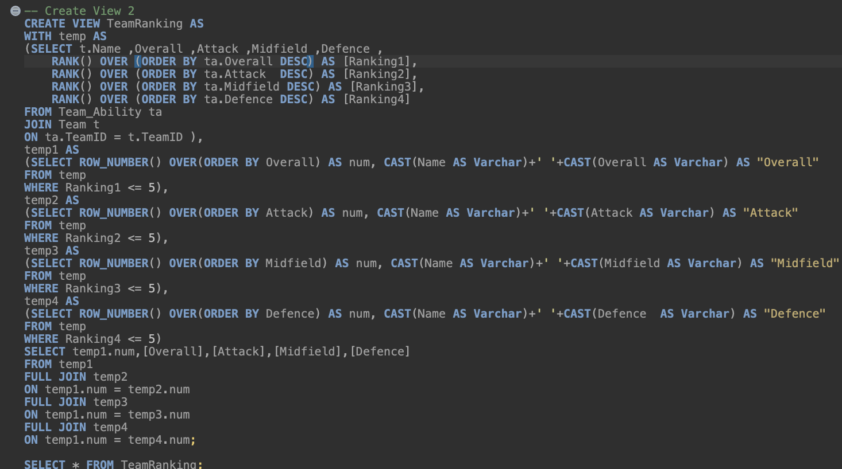
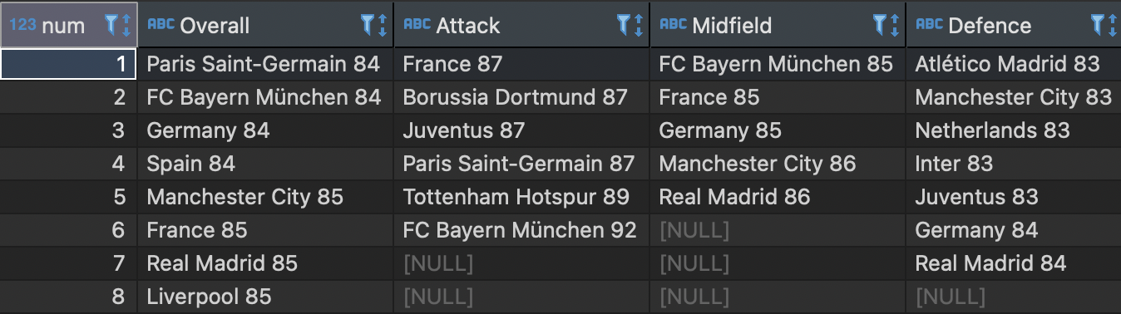
Part5 Views
Notes:
版权声明：300套精品模板商业授权，请联系【锐旗设计】:https://9ppt.taobao.com，专业PPT老师为你解决所有PPT问题！

Slide 10
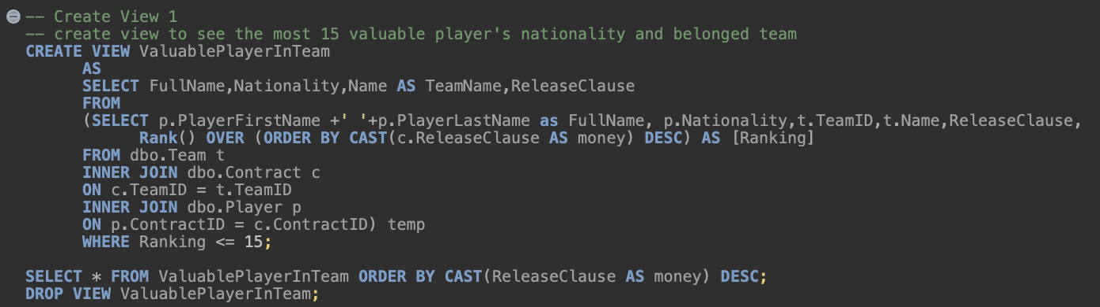
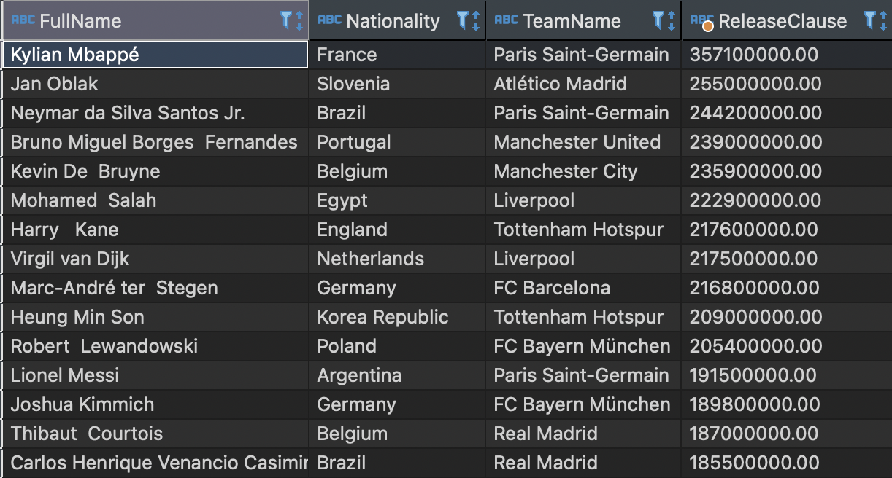
Part5 Views
Notes:
版权声明：300套精品模板商业授权，请联系【锐旗设计】:https://9ppt.taobao.com，专业PPT老师为你解决所有PPT问题！

Slide 11
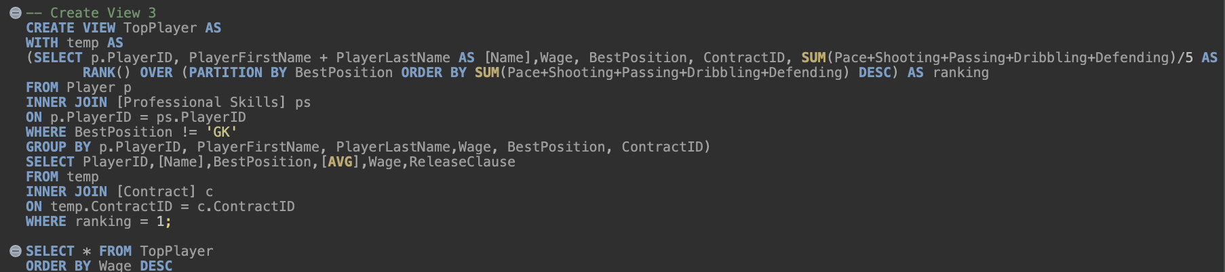
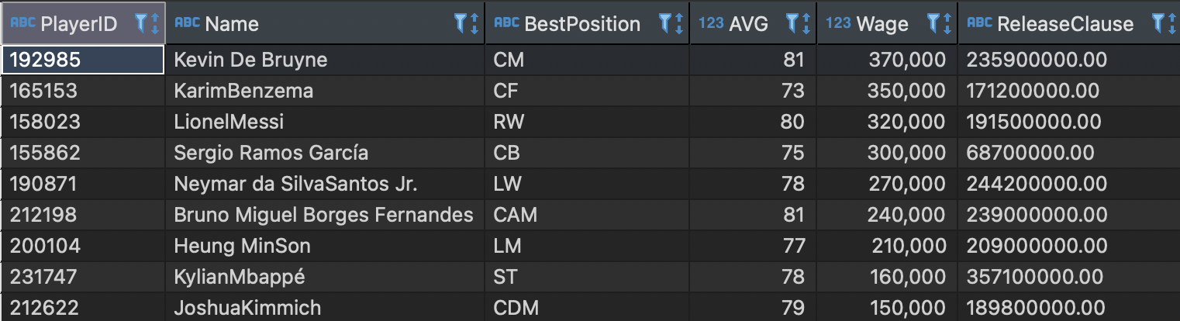
Part5 Views
Notes:
版权声明：300套精品模板商业授权，请联系【锐旗设计】:https://9ppt.taobao.com，专业PPT老师为你解决所有PPT问题！

Slide 12
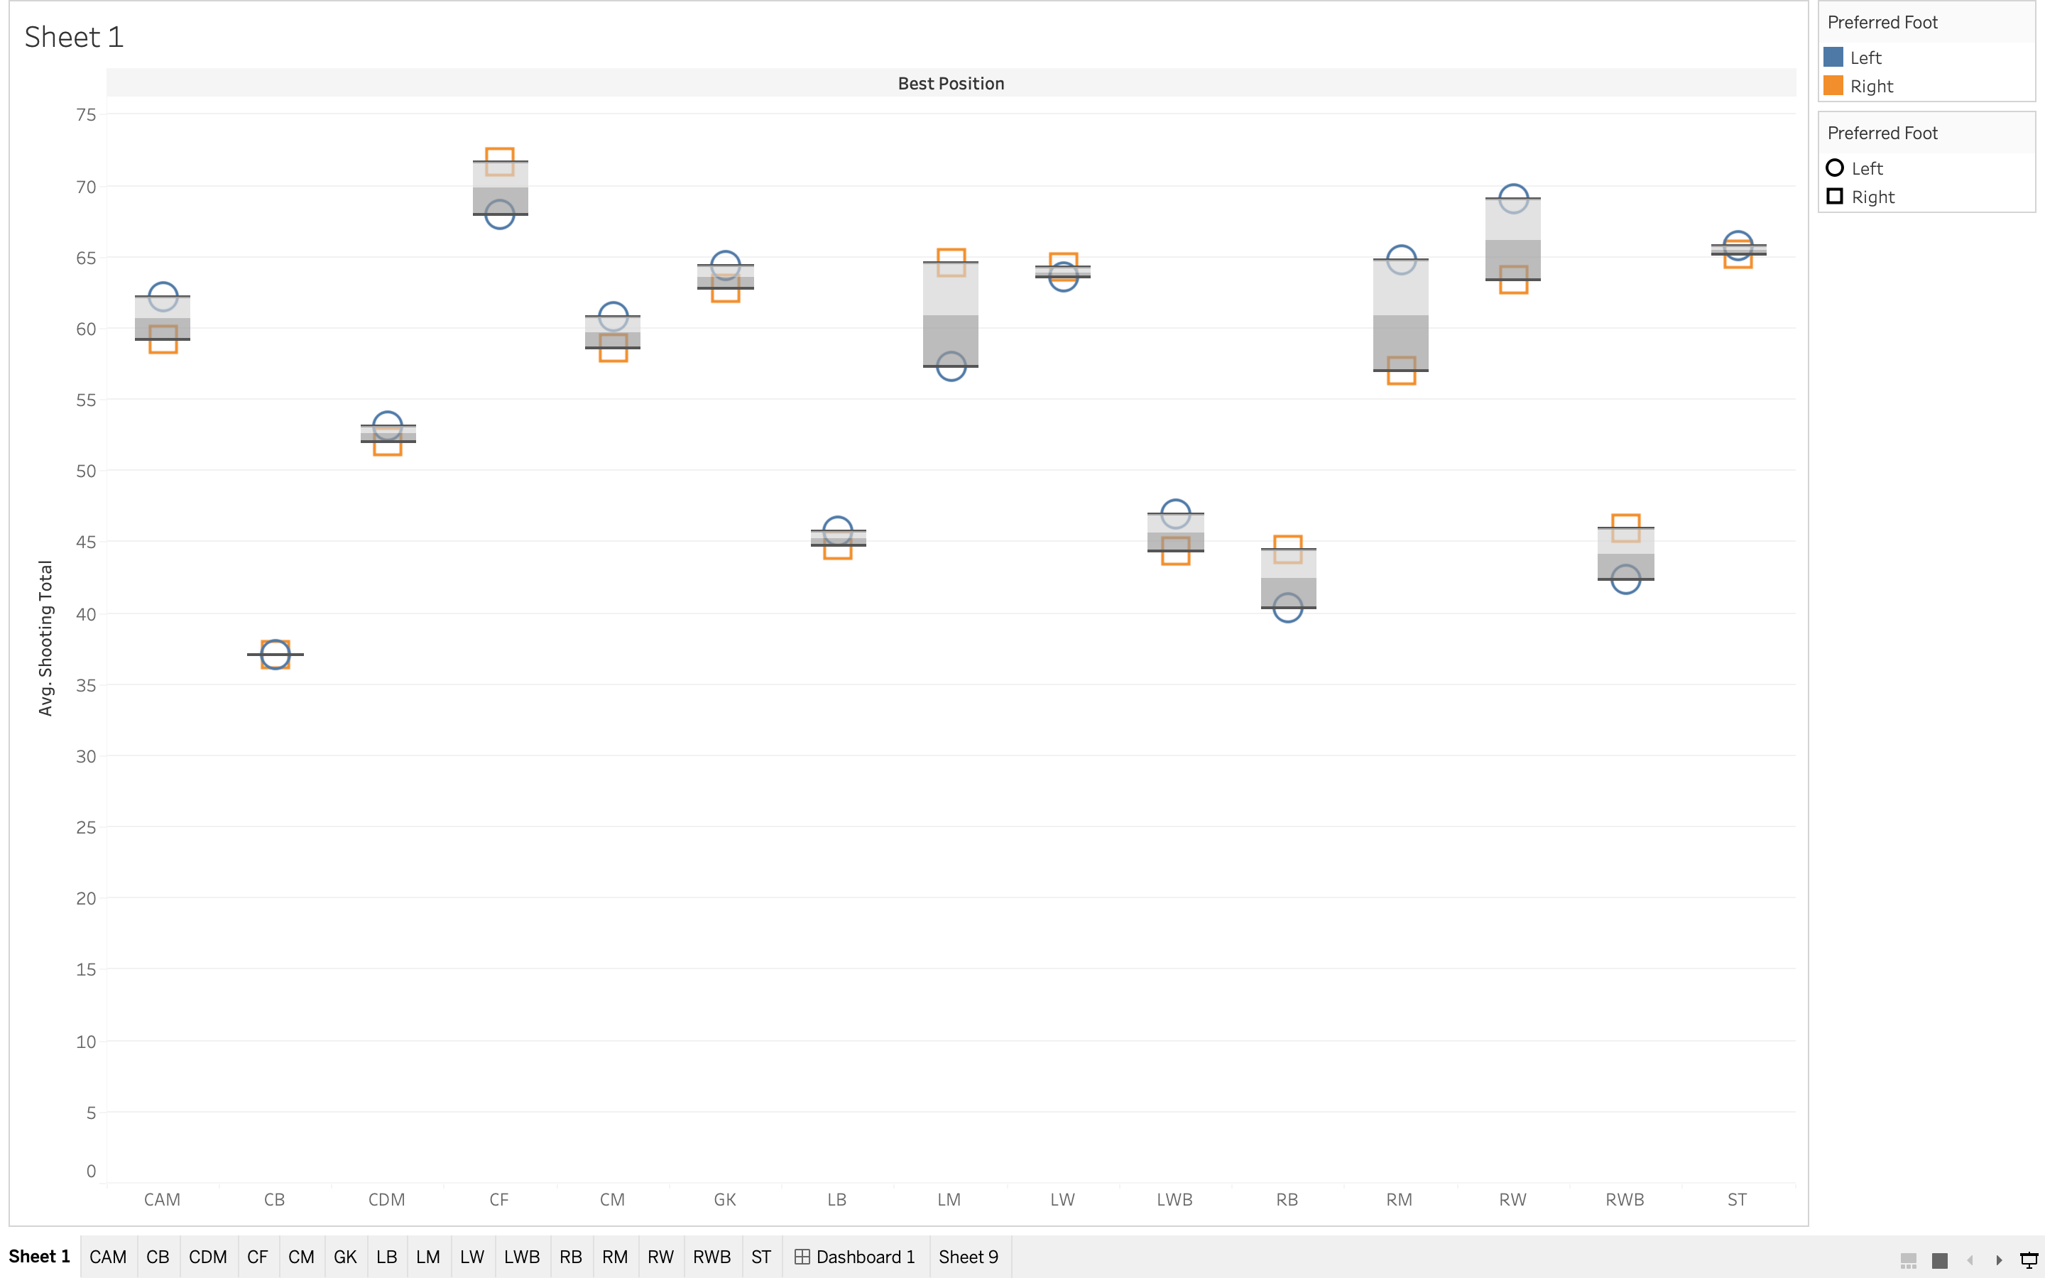
Part6 Tableau

Slide 13
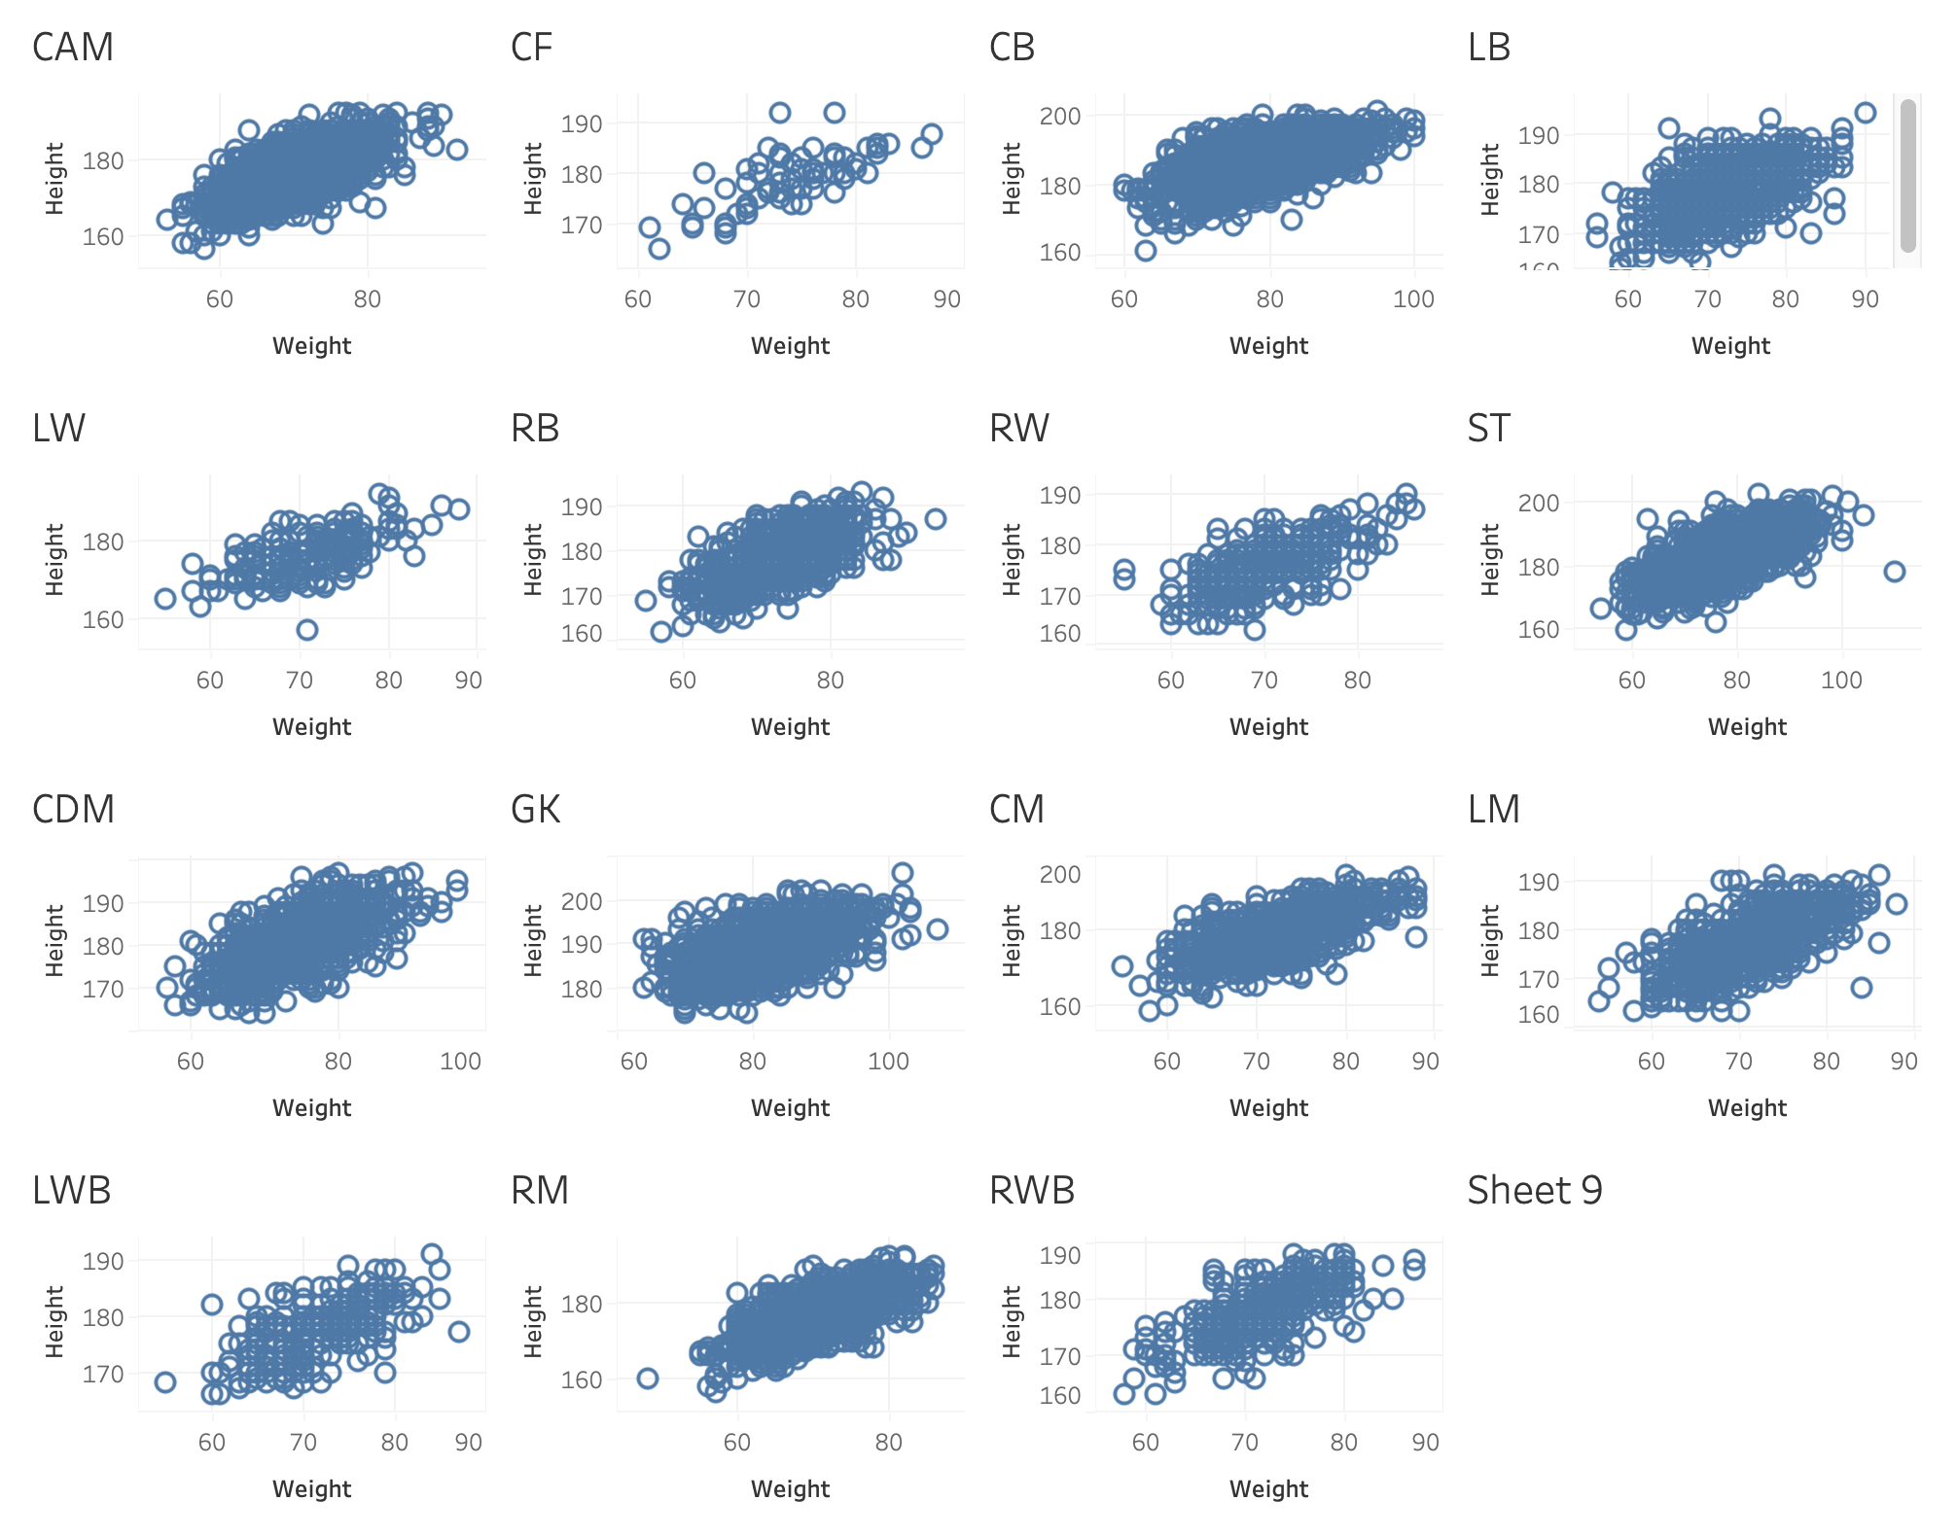
Part6 Tableau

Slide 14
THANK YOU
Notes:
版权声明：300套精品模板商业授权，请联系【锐旗设计】:https://9ppt.taobao.com，专业PPT老师为你解决所有PPT问题！

